Slide 1
Predicting Employee Attrition
Aseel Al Shammari

Slide 2
Problem Statement

Slide 3
Using data for Predicting Employee Attrition since the attention has increasingly been paid to human resources (HR), and worker quality and skills represent a growth factor and a real competitive advantage for companies. After proving its mettle in sales and marketing, artificial intelligence is also becoming central to employee-related decisions within HR management.

Slide 4
Data & Source

Slide 5
The data contains 19,104 instances (employees) with other features such as Age, gender, city, Date of joining, Last working date, Designation etc.
The data is from Kaggle in where it used to aid staffing, and it provided with the monthly information for a segment of employees for 2016 and 2017 and tasked to predict whether a current employee will be leaving the organization in the upcoming two quarters (01 Jan 2018 - 01 July 2018) or not, given:
Demographics of the employee (city, age, gender etc.)
Tenure information (joining date, Last Date)
Historical data regarding the performance of the employee (Quarterly rating, Monthly business acquired, designation, salary)

Slide 6


Data Preparation Tools
Missing Values
Outliers

Slide 7
Model
LogisticRegression
DecisionTreeClassifier
RandomForestClassifier

Slide 8
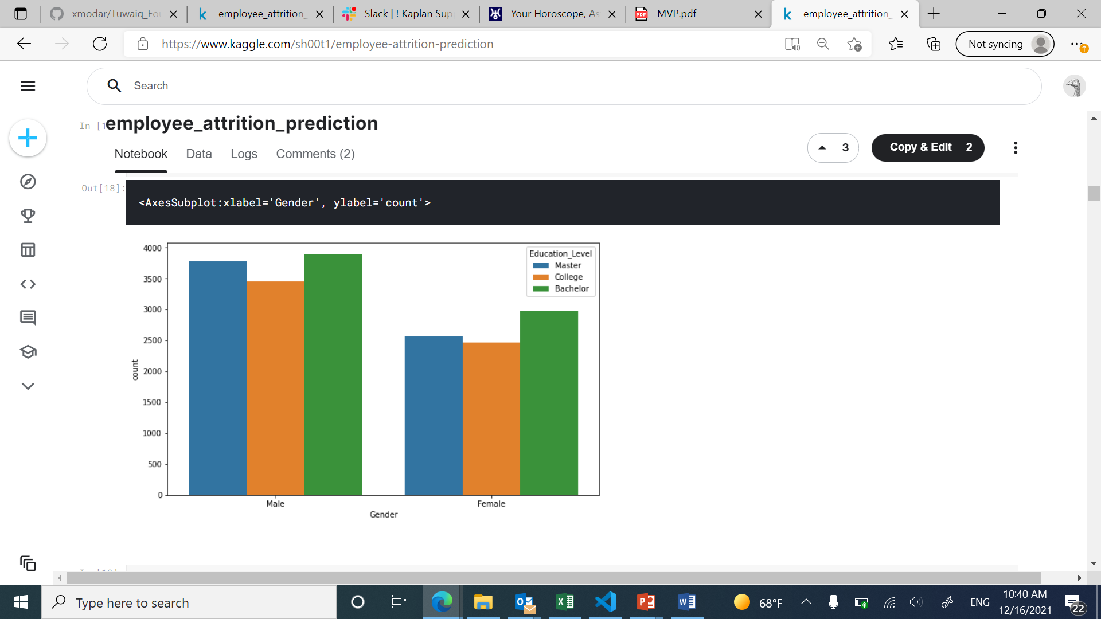
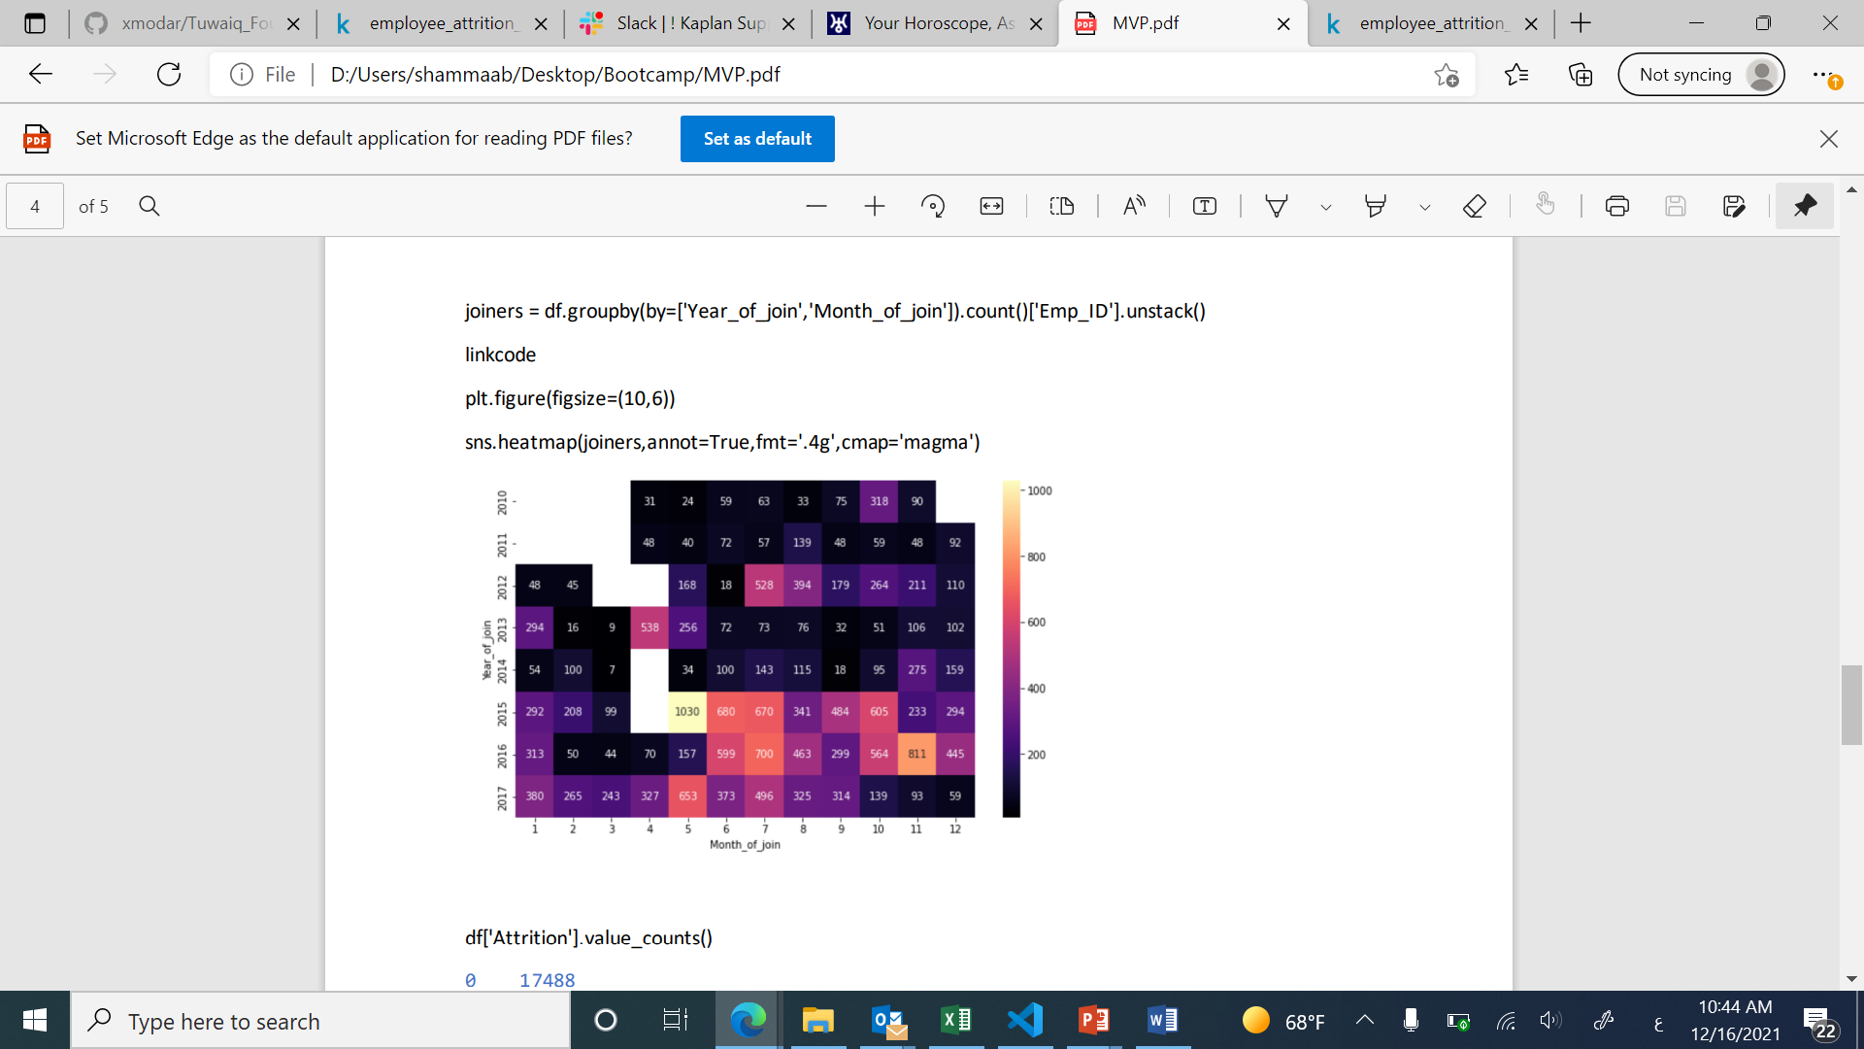
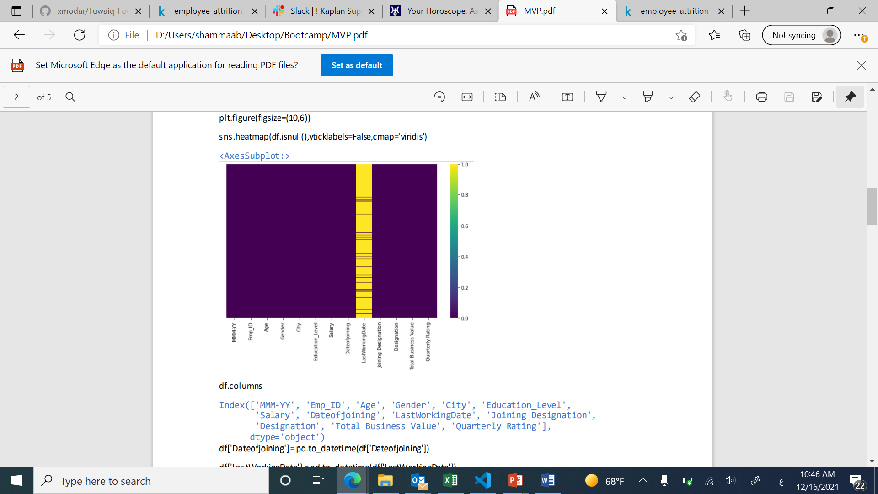
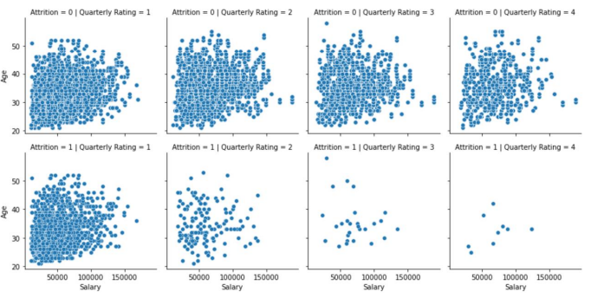
Data Analysis

Slide 9
Train and Test Datasets
Data will be split into half:
50% of the datasets would be for testing
And the other 50% will be for training

Slide 10
Thank You

